Slide 1

Office of Human Rights and Conflict Management

Slide 2
Agenda
OHRCM & Supports Available
Understanding Conflict & Communication
Your Default Position
Models and Tools
Final Thoughts
Office of Human Rights and Conflict Management ( November 2024)

Slide 3
Office of Human Rights and Conflict Management (OHRCM)
Address staff, student and faculty experiences of harassment and discrimination under the Ontario Human Rights Code and the Occupational Health and Safety Act.
Support and Respond to matters concerning:
Harassment
Discrimination
Gendered and Sexual Violence
Policies:
  6.1 Prevention of Harassment, Discrimination
  and Sexual Misconduct (staff, students and faculty)
  12.4 Prevention of Sexual Violence Policy & Procedures (students)
Office of Human Rights and Conflict Management (November 2024)

Slide 4
OHRCM Supports Available
Conflict Management:
Consultation ​
Education​
Informal resolution​
Common ways we address conflict:​
Facilitated conversations and/or circles with those affected.​
One-on-one coaching to learn skills and strategies to resolve
a current conflict or future conflict.​
Workplace or group restorations.
Office of Human Rights and Conflict Management (November 2024)

Slide 5
Connecting With Our Office
Meeting is booked ahead of time via email, or in office.
Meet to hear about experience; confidential.​
Ask what is needed (support, resolution, etc.)​
Provide resolution options and the individual decides how/if to proceed.​
Informal and formal processes available.
If appropriate, we provide them with a referral to another area (ALC, financial aid, Wellness Centre, etc.)​
humanrights@wlu.ca
svinfo@wlu.ca
Office of Human Rights and Conflict Management (November 2024)

Slide 6
Understanding Conflict & Communication
Unhealthy vs Healthy

Slide 7
What is Conflict
Three key types of conflicts:
Task - involves concrete issues related to the completion of a task, or activity.
Relationship – differences in personality, conflict styles, communication styles.
Value - fundamental differences in identities and values, which can include differences in politics, religion, ethics, generations, and other deeply held beliefs.
Office of Human Rights and Conflict Management (November 2024)

Slide 8

How Are We Defining Conflict
3 Components
Disagreement
Interference of goal or accomplishment
Negative Emotion
Office of Human Rights and Conflict Management (November 2024)

Slide 9
What Are The Causes
Expectations differences
Generational differences
Sharing of tasks
Differing communication styles - direct vs. indirect
Stressors, deadlines – inside and outside of work
Value differences
Office of Human Rights and Conflict Management (November 2024)

Slide 10
Unhealthy Conflict
Name calling, threatening, physical violence or dominance.
Excessive blaming.
Yelling, interrupting, invalidating feelings.
Denial of behaviours or that the conflict exists.
Silence, cold shoulder, shutting out, avoiding
Agreeing to engage in resolution but not following through; agreeing to the process but not in good-faith.
Office of Human Rights and Conflict Management (November 2024)

Slide 11
Healthy Conflict
Both free to disagree and have differing opinions.
Is an opportunity to give space for each other to be heard; calmly discuss.
We may say the wrong thing but are willing to apologize/take responsibility.
There is no winner or loser; resolution means you are both working towards being heard and coming to an agreed way to move forward.
Understanding while conflict can be hard, it is also an opportunity to grow.
Office of Human Rights and Conflict Management (November 2024)

Slide 12
Healthy Communication
Self-aware, self-reflective (Your default position, triggers, patterns)
Engage in self soothing
Focus on the content, remain mindful and present
Non-verbal communication (eye contact, posture, tone)
Reflect empathy
Identify common ground, relatedness
Be willing to move through miscommunications
Avoid accusatory language, use I statements, they reduce defensiveness.
Avoid absolutes “ you always/never”
Take a break when needed
Office of Human Rights and Conflict Management (November 2024)

Slide 13
Understanding Your Default Position

Slide 14
Your Default Position
Self Awareness​
The ability to be aware of your thoughts and feelings as you experience them and to articulate them​
Recognizing how your behaviour impacts others​
Ability to self reflect and correct behaviour
Reflection
Communication patterns and conflict style
Triggers
Relationship with feedback or criticism
Office of Human Rights and Conflict Management (November 2024)

Slide 15
Dysregulation
Bodies physiological response to a perceived threat/danger
Fight, flight, freeze, fawn. These responses are activated by your amygdala. Which causes a stress hormone (norepinephrine) to tell your body to prepare for the threat.
Dysregulated nervous system
Elevated heart rate
Sweating
Hot flashes
Shaking
Increased blood pressure
Nausea
Muscle tightness
Dry mouth
Office of Human Rights and Conflict Management (November 2024)

Slide 16
Your Triggers
Present triggers – Things that are currently affecting our mood and emotions.
Past triggers- Things from our past that influence how we respond to emotional situations today.
Office of Human Rights and Conflict Management (November 2024)

Slide 17
Common Triggers – Needs/Values
Acceptance Autonomy Accountability
Being in control Being valued Fairness
Being understood Being recognized Inclusion
Consistency Being liked Access needs
Order Being loved Safety
Respect Gratitude Connection/Awareness
Loyalty Variety
Office of Human Rights and Conflict Management (November 2024)

Slide 18
Models and Tools
For Healthier Conversations

Slide 19
Regulation: STOP and Breathe
Breath 1: Acknowledge your first reaction, but don't do it
(which is usually to defend yourself from the perceived attack)
Breath 2: Acknowledge your second reaction, but don't do it
(which is usually to retaliate against the other person)
Breath 3: Now that you've given yourself a moment to get past defending yourself and retaliating, try to find a solution
You may find it helpful to
say to yourself “stop” before you respond
vocalize to folks involved that you need a minute to respond
Office of Human Rights and Conflict Management (November 2024)

Slide 20
Emotional Regulation: Grounding
When dysregulation occurs:
Pause take some slow breaths
Take a break 20 mins minimum
Vocalize your commitment to the conversation/finding resolution and advocate for the time you need to recalibrate.
Self sooth using SSSTT- Sight Sound Smell Touch Taste:
Sight- look at something enjoyable
Sound- listen to something you find soothing (music, nature)
Smell - essential oils are great for grounding
Taste – Tea, a mint, something sour or chew gum (The act of chewing, tricks your brain into thinking your safe, were safe when eating)
Touch - use a stress ball or another fidget, silly puddy, a smooth stone
Debrief afterward
Office of Human Rights and Conflict Management (November 2024)

Slide 21
Contrasting
Contrasting​
Is used to clarify expectations and minimize misunderstanding. ​
I do want….. I don’t want…….
Office of Human Rights and Conflict Management (November 2024)

Slide 22
Facts vs. Stories
If you recorded it, the facts are what you can see and hear. Until someone confirms otherwise, the rest are just stories.
Don’t base your assumption of the conflict on stories.
Facts are:
  The least controversial
  More persuasive
  The least insulting
Office of Human Rights and Conflict Management (November 2024)

Slide 23
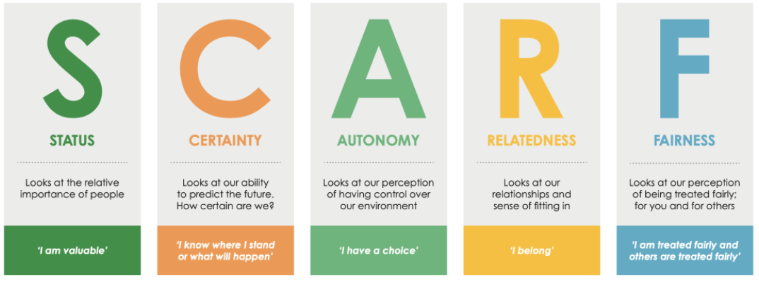
SCARF Model – Why Are they So Bothered?
Office of Human Rights and Conflict Management (November 2024)

Slide 24
SCARF Model
Feeling threatened can:
Prevent us from feeling safe
Make communication challenging
Block creativity and problem solving
Feeling rewarded can:
Create empowerment and greater self-confidence
Provide more opportunities for communication
Foster a positive work environment
Office of Human Rights and Conflict Management (November 2024)

Slide 25
SCARF Model
Observe how you react to people:
  How are you at work, school, home?
  How do you respond in stressful situations?
  Consider how your actions will affect others – before you take those actions.
  How can you make an interaction feel rewarding and not threatening?
Office of Human Rights and Conflict Management (November 2024)

Slide 26
Apology
Apologize
"I’m sorry" statement.​
An expression of regret for what happened.​
An acknowledgment that social norms or expectations were violated.​
An empathy statement acknowledging the full impact of actions on the other person.​
A request for forgiveness.
Office of Human Rights and Conflict Management (November 2024)

Slide 27
Final Thoughts
When someone shares a concern:
Staying curious; ask questions to better understand.
Avoid blaming; suspecting judgement.
Know and challenge your default position (style, triggers).
Separate the person from the problem - recognize humanity
Look for opportunities for community building and resolution.
Office of Human Rights and Conflict Management (November 2024)

